Slide 1


AI - Lead Generation & Prospecting
Masterclass One

Slide 2

Learning Outcomes
Have a better understanding of the areas where AI can support lead generation – and where it cannot;
Discover how AI can be used to create buyer personas and account profiles;
Learn about buying units and other customer insights through AI;
Understand how to identify market size and other market insights via AI tools;
Learn about AI’s role in understanding accounts; and
Discover how to use AI tools for prospecting.

Slide 3
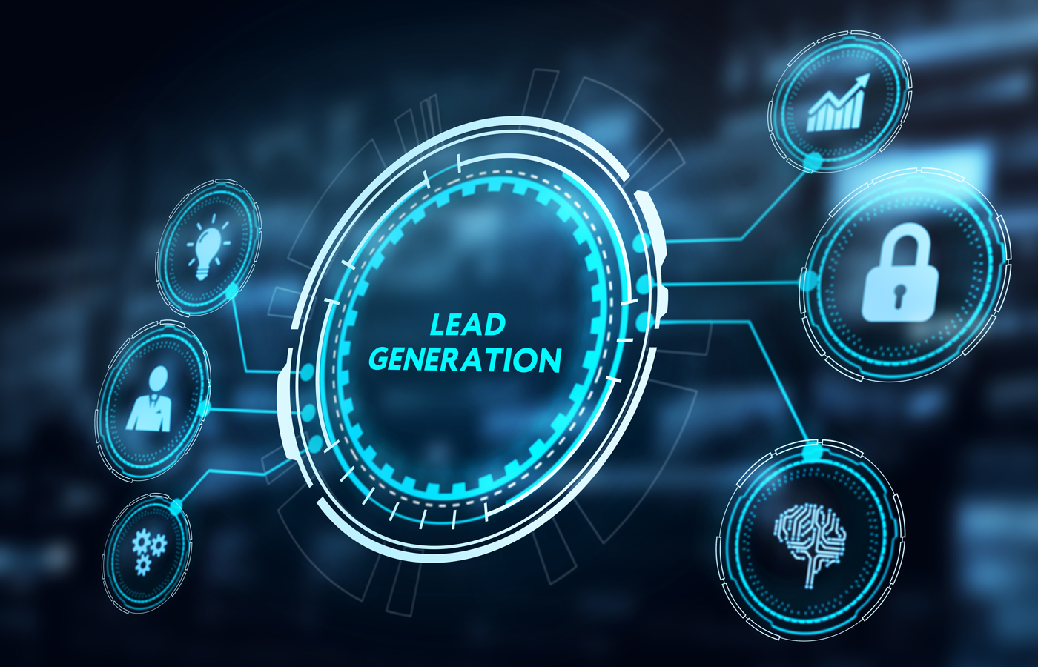
Module One:
Lead Gen, AI and Key Areas
Leads, lead generation and the lead generation process;
AI trends in lead generation;
Where AI plays a role in B2B marketing and lead generation;
AI’s role for lead capture and lead nurturing; and
How AI benefits and transforms lead generation.

Slide 4

Module Two:
AI and Customer, Market & Competitor Insights
Identifying key customer segments and personas;
AI to deepen understanding of customers and how to use in creating buyer personas;
AI for identifying stakeholders;
Learn how to use AI tools for understand prospects needs, pain points; and
AI tools for predicting customer behaviours.

Slide 5

Module Three:
Account Insights & Research
AI for identifying suitable leads, to find contact information;
AI for researching account;
AI for sizing market and industry opportunities;
AI to identify look-alike accounts; and
Market and competitive insights and AI.

Slide 6

Conditions & Pricing
½ day duration (4 hours)
Online delivery
Maximum ten attendees per class
$AUD 1,950 per person
10% discount for ISP partners

Slide 7
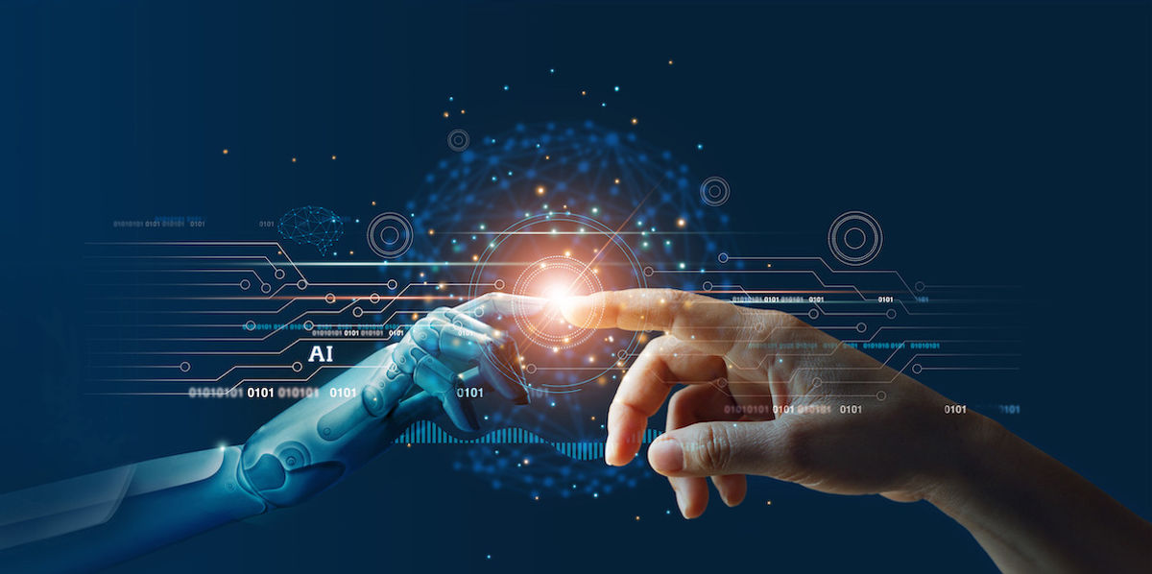
www.revenuetek.com/masterclasses

